Slide 1
Bank Report
File created on: 06-04-2024 22:43:41

Slide 2
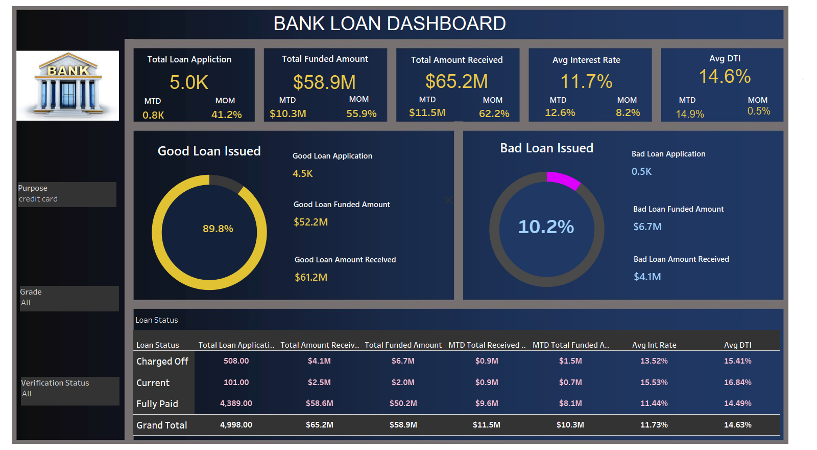

Slide 3
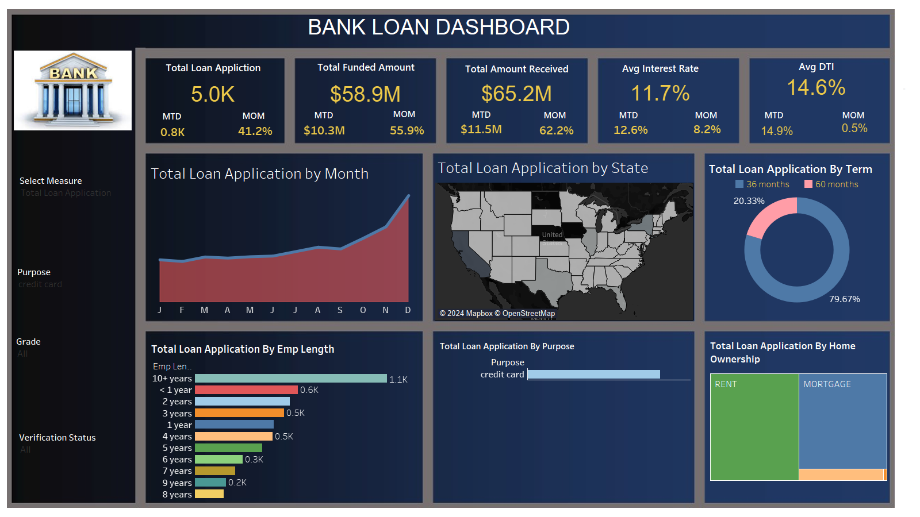

Slide 4
